Slide 1


E-COMMERCE DATA ANALYSIS
PRESENTED BY :
BHARATH SIMHA NAIDU M

Slide 2



Agenda
PROBLEM STATEMENT | 3
DATA REQUIRMENTS | 4
DATA COLLECTION | 5
DATA VALIDATION | 6
DATA CLEANING | 7
TOOLS USED | 8
GRAPHS & INSIGHTS | 9
DASHBOARD | 10

Slide 3

E-commerce businesses need to understand transaction trends, customer behaviors, and payment patterns to optimize pricing strategies, improve customer experience, and drive sales growth.
PROBLEM STATEMENT

Slide 4

CATEGORY
PAYMENT METHODS
USER ID
PRODUCT ID
DISCOUNT
PRICE
FINAL PRICE
DATA REQUIRMENTS

Slide 5
Back to Agenda
DATA COLLECTION
Primary data given by examiner.

Slide 6

DATA VALIDATION
Data which I got is valid.
No validation required.

Slide 7
No data cleaning required as i got the clean data from reliable source
DATA CLEANING
If required we can use these tools :
python
SQL
tableau
power BI

Slide 8
Tableau was the tool that im using to analyse this data
TOOLS USED

Slide 9

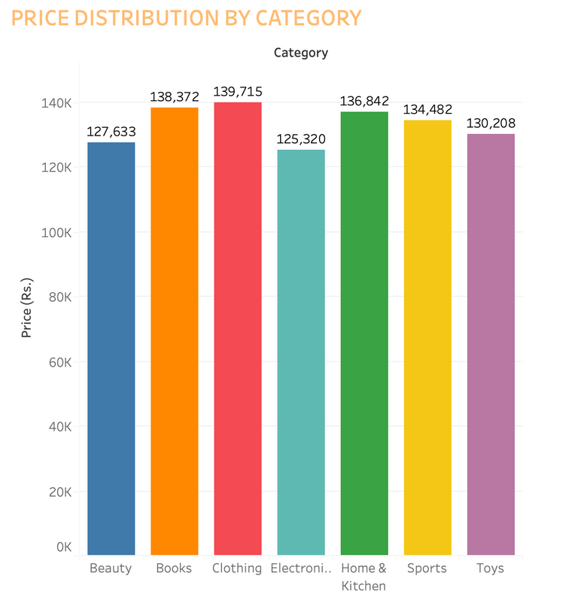
PRICE DISTRIBUTION BY CATEGORY
Insight:
Books (₹138,372) and Clothing (₹139,715) have the highest price distribution among categories, whereas Toys (₹130,208) and Beauty (₹127,633) have the lowest.
Actionable Insight:
Focus on marketing higher-value categories like Clothing and Books to boost revenue.
Price optimization for categories like Beauty and Toys may increase their competitiveness.

Slide 10
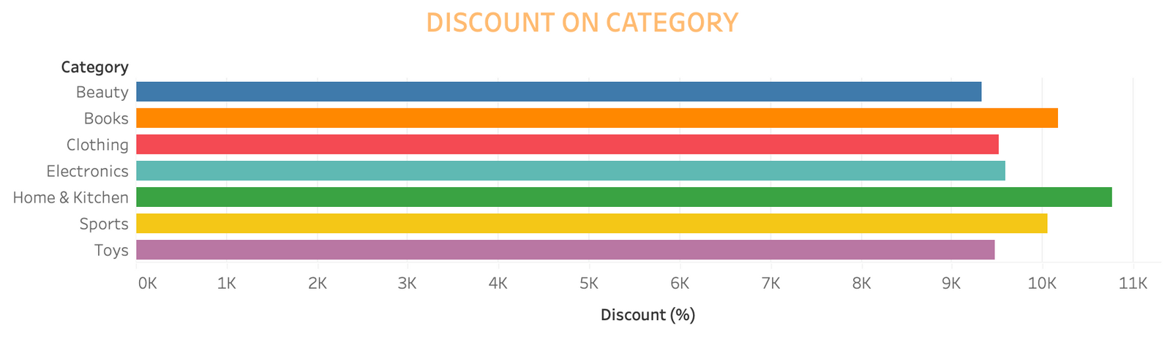
DISCOUNT BASED ON CATEGORY
Insight:
Clothing and Toys offer the highest discounts (~10%), whereas Beauty and Home & Kitchen provide lower discounts (~6-7%).
Actionable Insight:
High discounts in categories like Clothing and Toys may drive sales but could impact profit margins.
Consider increasing discounts for lower-performing categories like Beauty to boost sales.

Slide 11
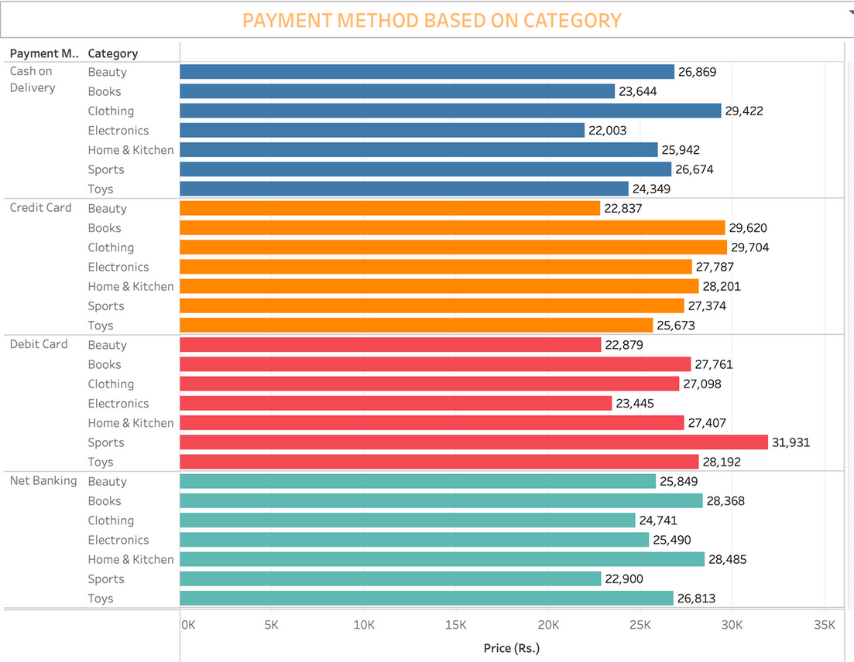
PAYMENT METHOD VS CATEGORY
Insight:
Credit cards are predominantly used for Electronics (₹27,787) and Home & Kitchen (₹28,201).
Cash on delivery is more popular for categories like Books (₹29,422) and Beauty (₹26,869).
Actionable Insight:
Offer attractive credit card discounts for higher-value items like Electronics.
Improve cash-on-delivery logistics for popular categories like Books.

Slide 12
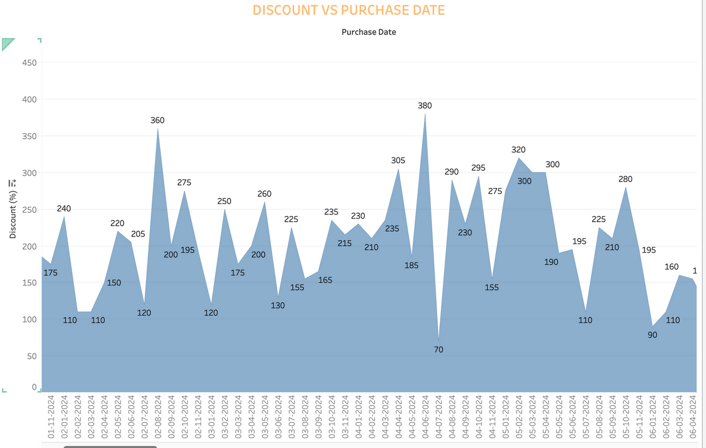
DISCOUNT VS PURCHASE DATE
Insight:
Discounts fluctuate widely across dates, ranging from as low as 45% to peaks of 460%.
Certain periods (e.g., around the 10th, 16th, and 20th of the month) show significant spikes in discounts.
Actionable Insight:
Align marketing campaigns with discount peaks to maximize visibility.
Even out discount fluctuations to maintain consistent customer expectations.

Slide 13
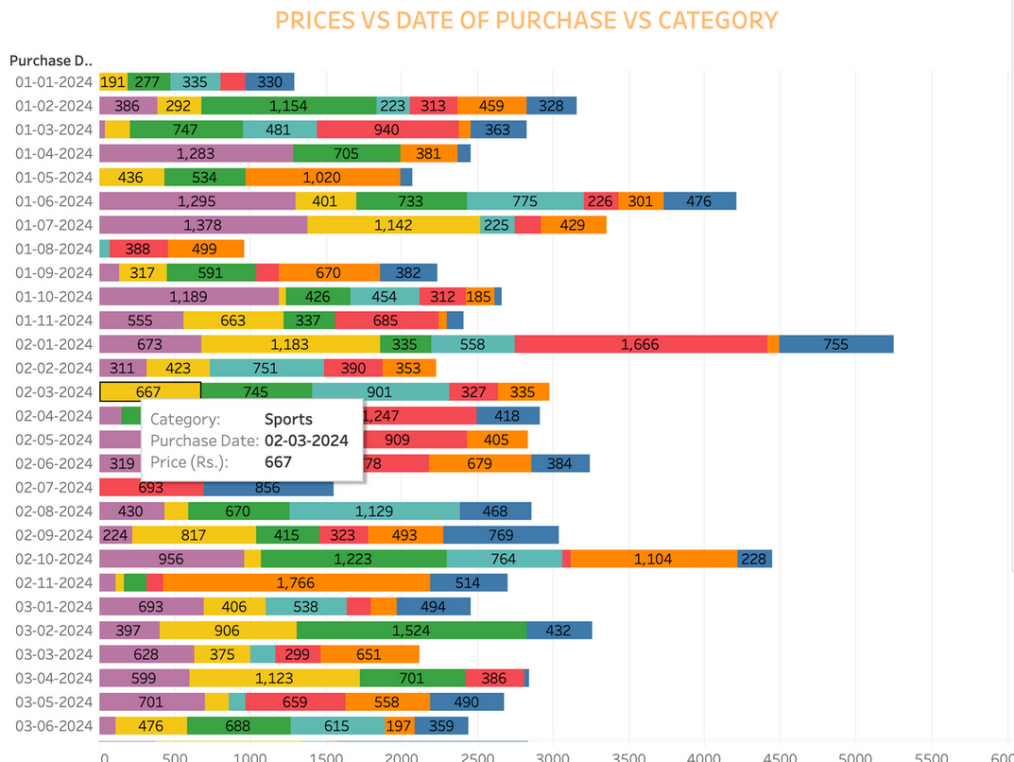
PRICE VS DATE OF PURCHASE VS CATEGORY
Insight:
Categories like Clothing (₹1,295) and Electronics (₹1,283) had the highest prices around 01-06-2024.
Toys and Sports show more balanced price trends across dates.
Actionable Insight:
Analyze customer demand trends around these peak dates to understand pricing sensitivity.
Leverage peak pricing periods for premium offerings in high-value categories like Clothing and Electronics.

Slide 14
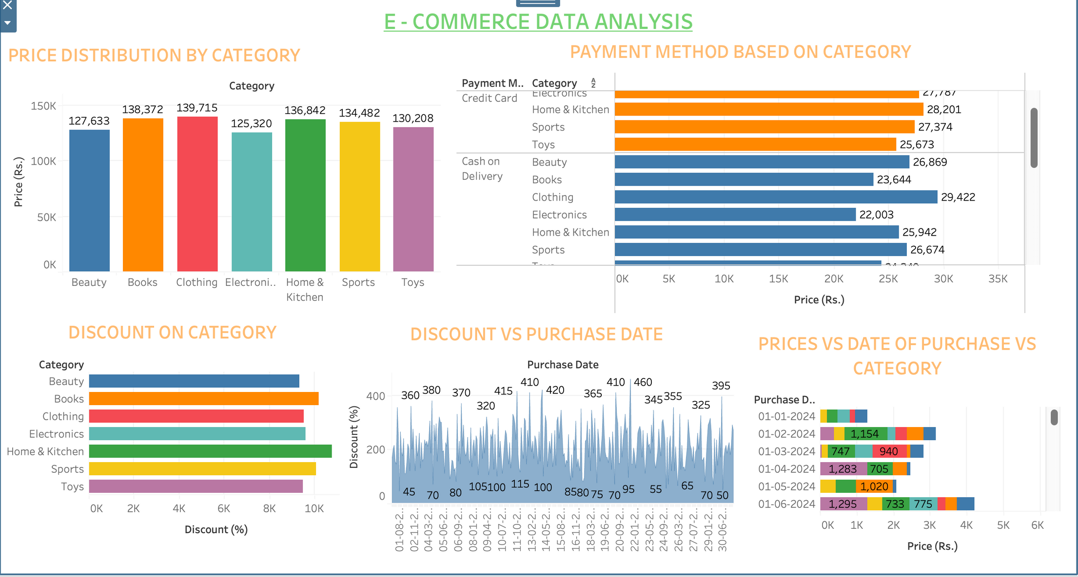
DASHBOARD:
Briefly elaborate on what you want to discuss.

